Slide 1

EMPLOYEE DATA ANALYSIS
Presented by: Gabriel

Slide 2

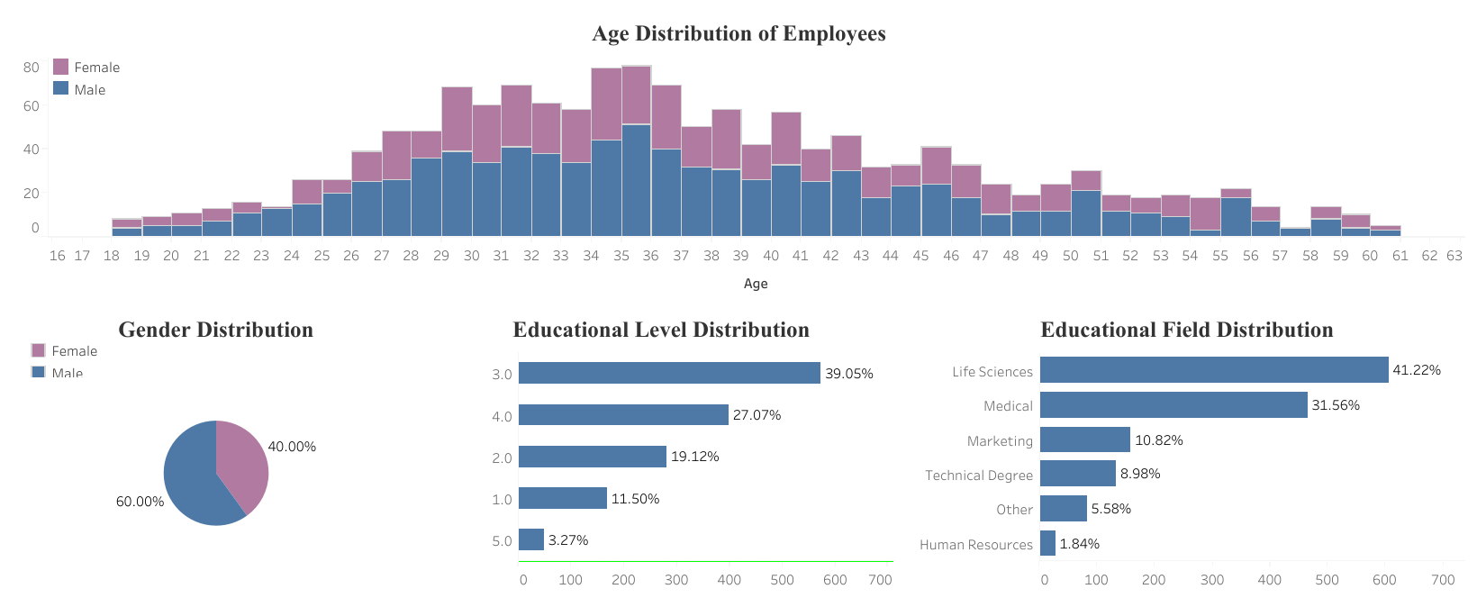
The Age range is between 18 – 60 years
The highest age frequency is 35 and most the workers fall between 30 and 40 years
The lowest age frequency is 60
Age 57 is the only age with one gender, there are no females aged 57
There are significantly more males than females
60% of the staff are Male, and 40% are Female
From the bar chart, we can see that:
Research and Development have the highest number of employees
Human Resources have the smallest number of employees
The most frequent educational level is 3.0
Very few number of employees have the highest educational level - 5.0
41.2% of the employees studied Life Sciences. It is the highest field of study
Only 1.84% studied Human Resources. It’s the least studied course

Slide 3
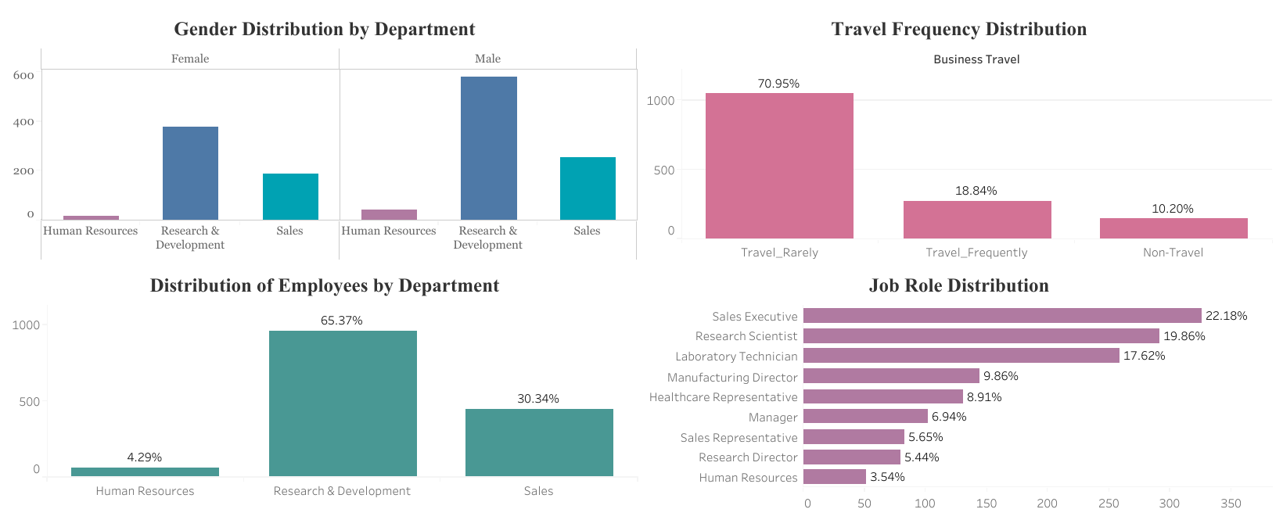
Research and Development have the highest number of employees, over 65 percent
Human Resources have the least number of employees, making up just 3.5 percent.
There are more males in every department
Most of the employees rarely travel
Only 18.84 percent of the employees travel frequently
10 percent of the employees have never travelled
Over 300 employees are Sales Executives, the most of any job role with 22 percent
A significant number of employees are either Lab Technicians or Research Scientists with 17.6 and 19.9 percent respectively
In total, there are 9 job roles

Slide 4
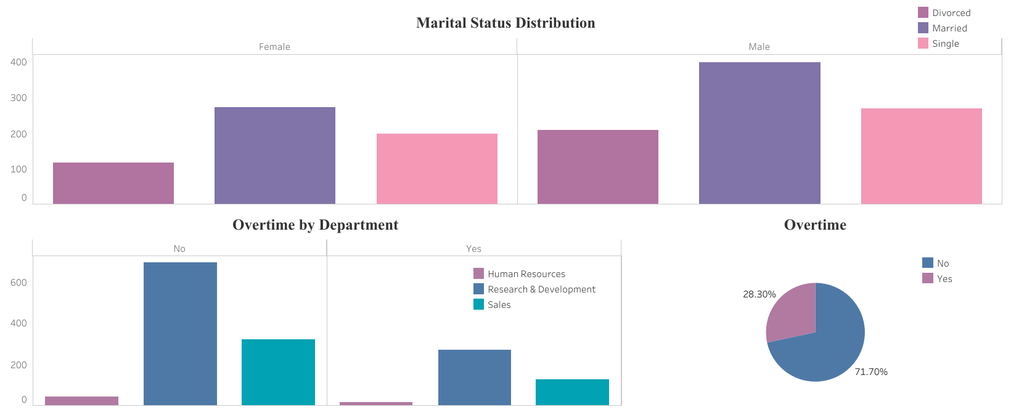
There are more married employees than single or divorced employees
Around 32 percent of the employees are single
22 percent of the employees are divorced
There are more married men than women
Over 70 percent of the employees do not work overtime
the most number of employees who work overtime are in Research and Development.
This makes sense as we already know around 65 percent of the employees are in R&D
Department does not affect overtime

Slide 5
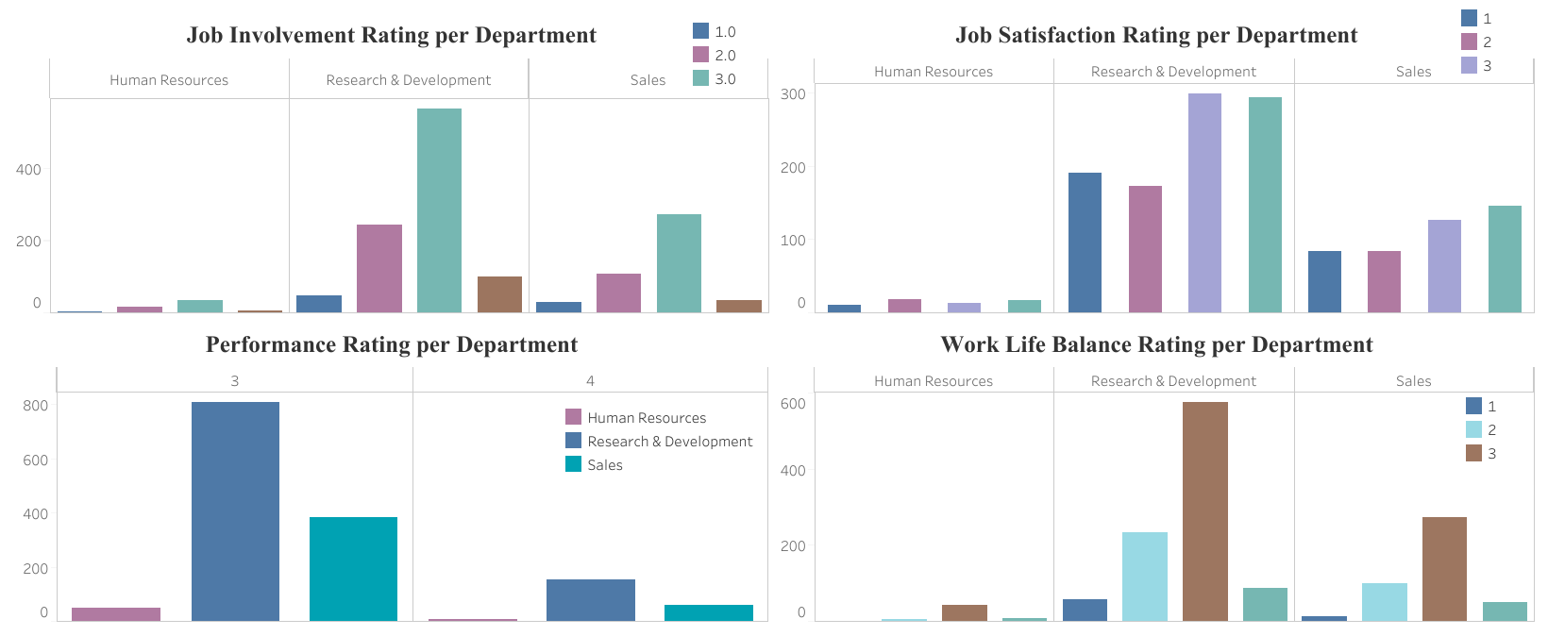
The most frequent Job Involvement level is 3.0 which is good
Very few employees have the highest job involvement rating of 4.0 which makes sense.
Also very few employees have a poor job involvement rating of 1.0
We can conclude that the Job involvement rating is very good as few workers have a poor rating
Most of the employees have a Job Satisfaction rating of 3.0 or 4.0
This means a high percentage of employees are satisfied with their jobs
The employees have a high performance rating
No employee has a performance rating lower than 3.0
Most employees have a work life balance of 3.0
Very few employees have a poor work life balance of 1.0-2.0

Slide 6
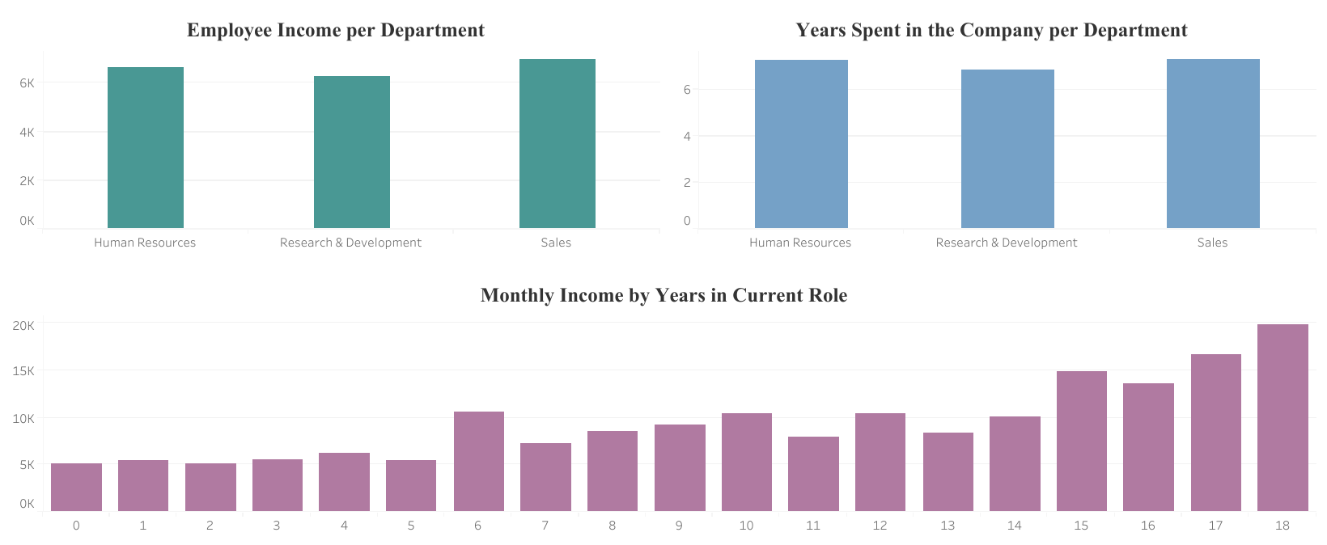
Interestingly, the employees in R&D have the lowest monthly income even though they have the most workers
Sales employees earn the highest in the firm
There are outliers of monthly income in every department, which is understandable
Human Resources have the highest degree of outliers with earnings above 8000 in some cases
Looking at the second plot, it makes sense that R&D employees have the least salaries as they have spent less time in the company
Human Resources employees have been at the company the longest
Generally, as expected, monthly income tends to increase as years in current role increases
Interestingly, there is an unexpected hike in salaries for employees in the 6 year column
At year 18, salaries are maxed out, and there are very few outliers which makes sense as they are already earning the highest in the company

Slide 7
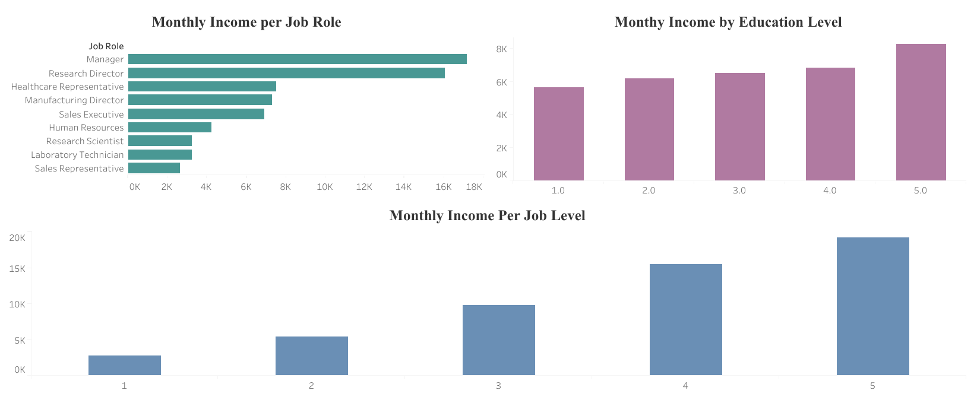
Managers earn the highest monthly income, closely followed by Research Directors
The salaries of Managers and Research Directors are far more than any other Job Roles
Sales Representatives earn the least monthly income
Laboratory Technicians and Research scientists earn the same amounts
As expected, The higher the education level, the higher the monthly income
At the highest educational level, there are very significant outliers
This means even though the educational level is the same, there are significant varying income levels based on other factors
As expected, the higher the job level, the higher the monthly income

Slide 8
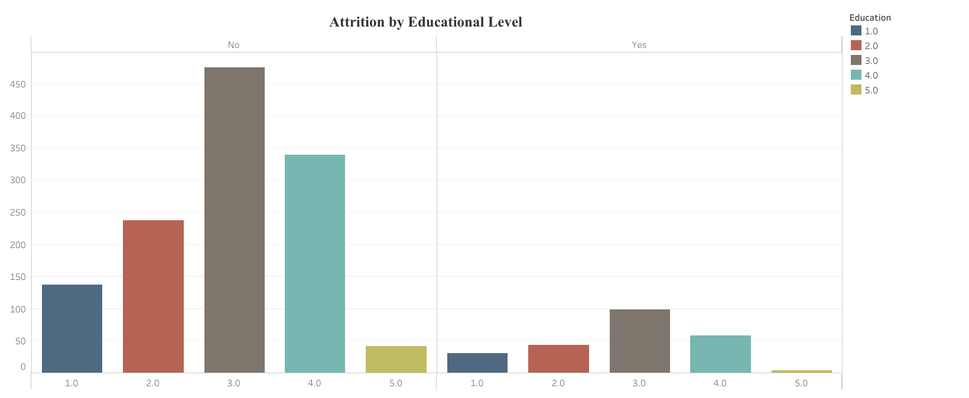
At the highest education level, attrition is very low
However, Attrition rate is significantly constant across the rest of the educational levels
Educational level does not play a significant role in attrition except at the highest level

Slide 9
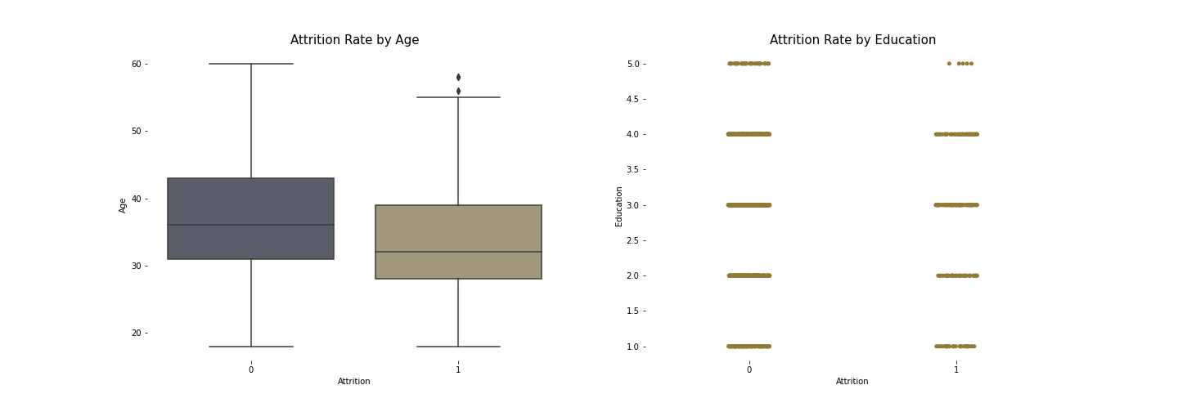
The Age distribution of workers who attrited is significantly lower than employees who didn't attrit
The older employees get, the chances that they attrit start to become lower
At the highest education level, attrition is very low
However, Attrition rate is significantly constant across the rest of the educational levels.
Educational level does not play a significant role in attrition except at the highest level

Slide 10
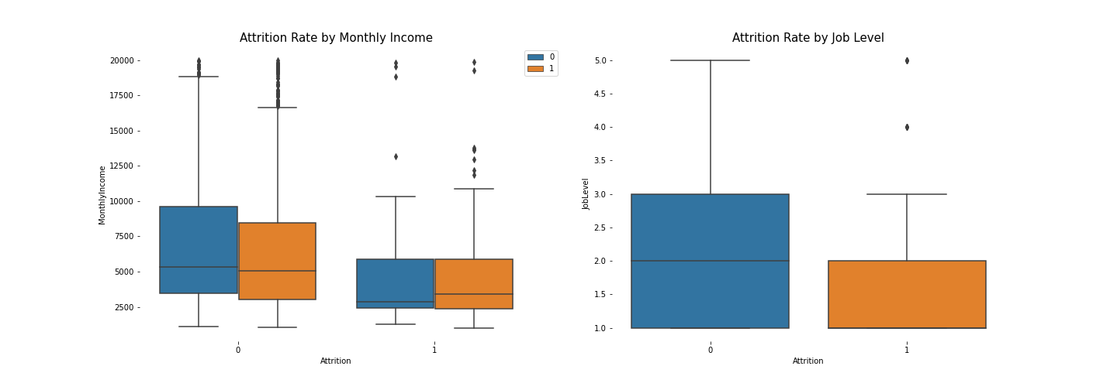


The monthly income of employees who attrited is significantly lower than those who didn’t.
Very few people earning above 12000 left the company
Gender does not affect attrition
Most of the employees that attrited were earning below 7500
Only two employees with Job Level above 3.0 have attrited
Most of the people who left the firm have a low job level between 1.0 - 2.0
Once an employee gets beyond Job Level 3.0, there is very slim chance of attrition

Slide 11
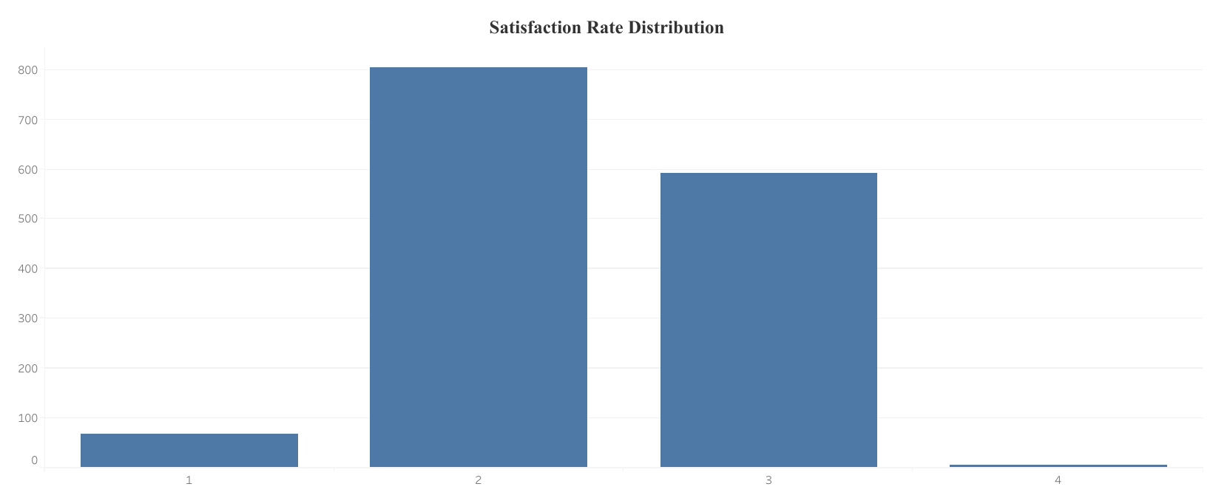
Almost half of the employees have a good Satisfaction Rate of 3.0
Just 0.5 percent of employees have a Satisfaction Rate of 1.0
10 percent of employees have a very high Satisfaction Rate

Slide 12

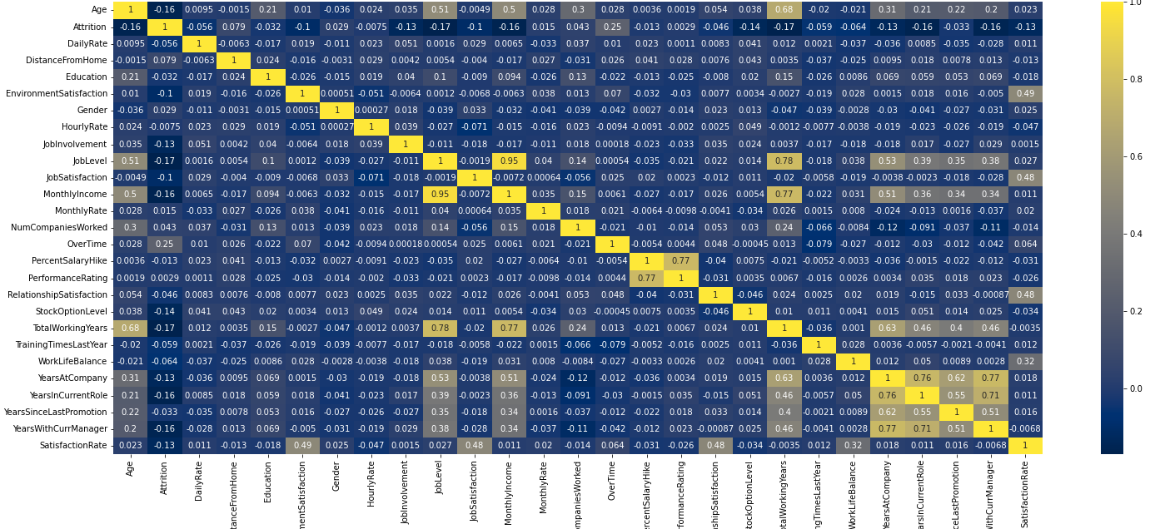
Correlation Heatmap

Slide 13
THANK
YOU

